Slide 1

Dietary habits and disease activity in rheumatoid arthritis patients
by: Hoang Linh Chi
Mittal Akash
Gomez Herrada Melany

Slide 2
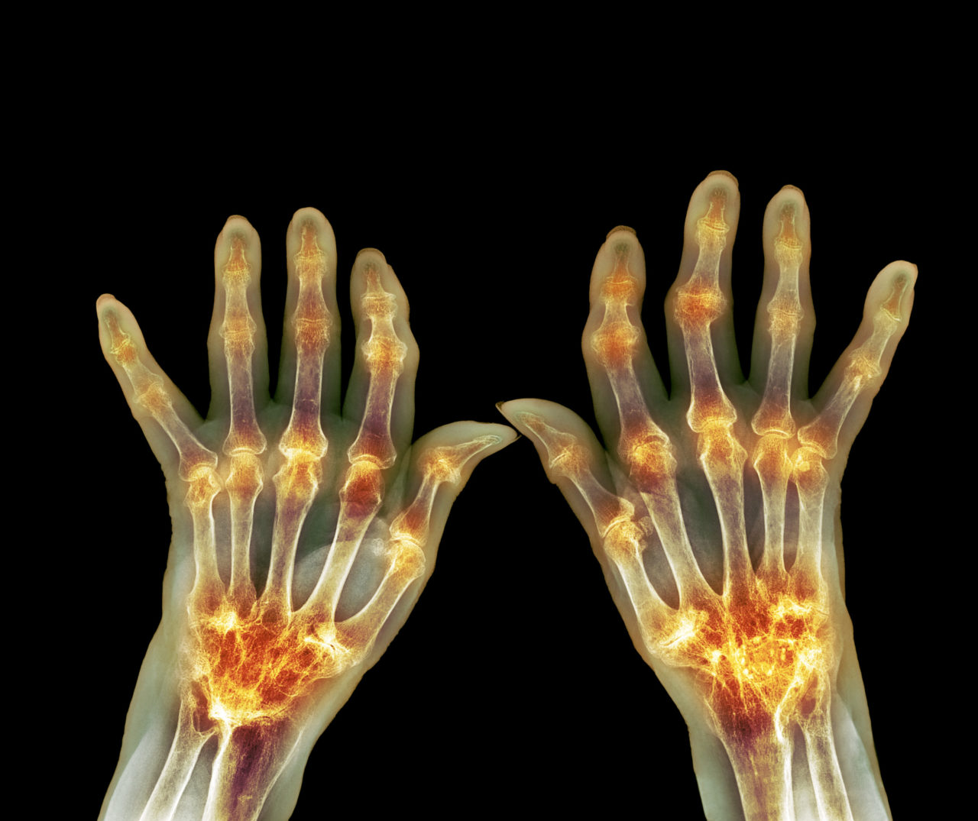
Introducction
Rheumatoid arthritis
is a chronic inflammatory disorder, it affects between 0.3% and 1.0% of the population.
Rheumatoid arthritis affects the lining of your joints resulting in bone erosion and joint deformity.
The inflammation can damage other parts of the body as well.
Severe rheumatoid arthritis can even cause physical disabilities.

Slide 3
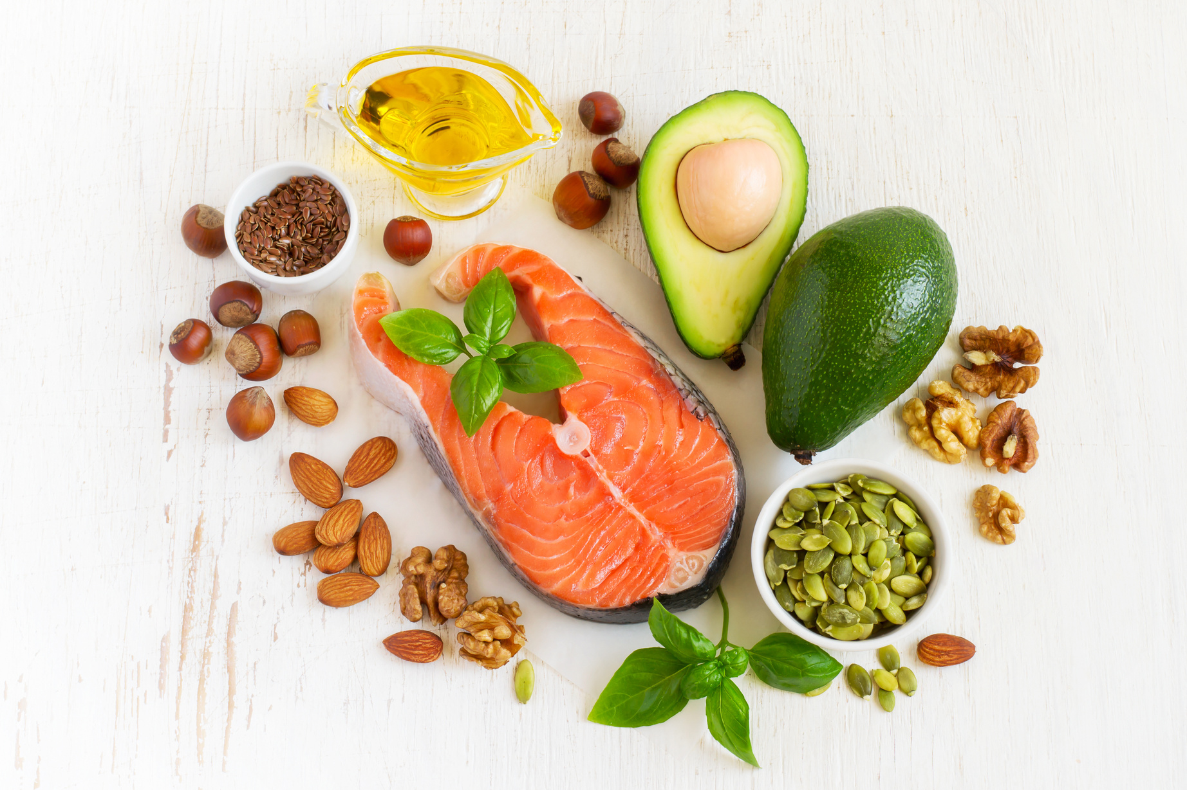
Rheumatoid arthritis and
dietary habits
In recent years, research has illuminated the pivotal role of diet and lifestyle in influencing the risk and progression of the illnesses.
Some nutrients, like polyunsaturated fatty acids, can combat inflammation. They also act as antioxidants, thus protecting against the onset of RA. Substances like salt and red meat have adverse effects.
RA treatment regimen may include dietary intakes as potential complementary therapies for RA.

Slide 4
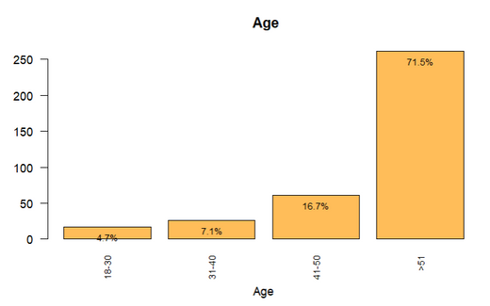
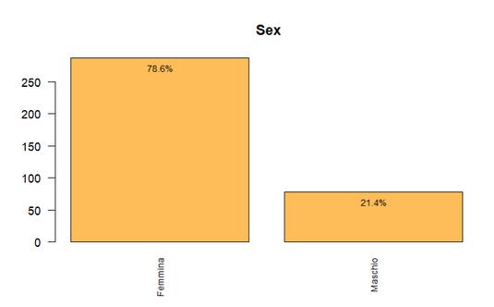
About the Dataset
The dataset is composed of 365 observations
and 499 variables:
Characteristics of Individuals
Activity and Severity of RA
Comorbidity (Other Diseases)
Drugs taken
Blood Levels
Nutrients
Foods (items and groups)
Disease Activity Score( DAS28)
Simplified Disease Activity Index (SDAI)
33 Food groups
redmeat
whitemeat
fish
fat_fish
leafy_vegetables
vegetables
cabbages
summer_fruits
alcoholic_beverages
potatoes
milk_yoghurt
seafood
eggs
sweets
snacks
legumes
onion_garlic
fruits_allseasons
unsweetened_beverages
soft_drinks
whole_grains
stagionato_cheese
dried_fruit
nuts
olive_oil
seed_oil
mushrooms
soy_products
winter_fruits
coffee
refined_grains
butter_margarine
other_cheese

Slide 5
Analysis steps
1
2
3
4
Data Cleaning & Transformation
Factorial Analysis for Food groups
Logistic Regression on Confounders
Combined Regression on Confounders and Food Groups.

Slide 6
FOOD GROUP BASED ANALYSIS

Slide 7
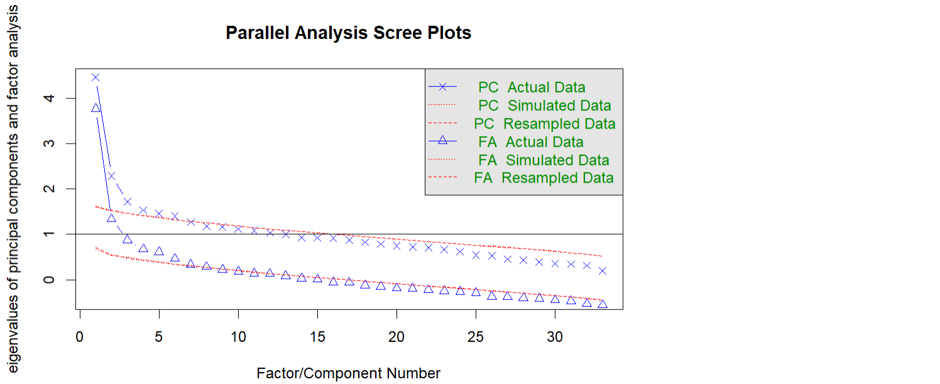
According to the Parallel Analysis Scree Plots, 7 factors are suggested. However, these factors only explain about 46% of the cumulative variance. Notably, by increasing the number of factors to 16, around 70% of the variance can be explained.

Slide 8
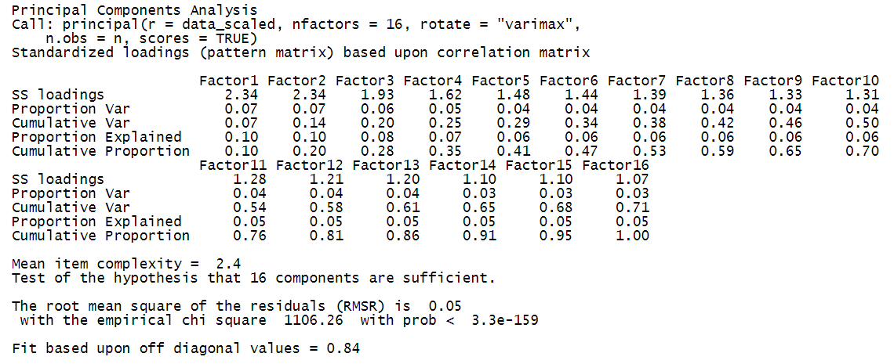

Slide 9
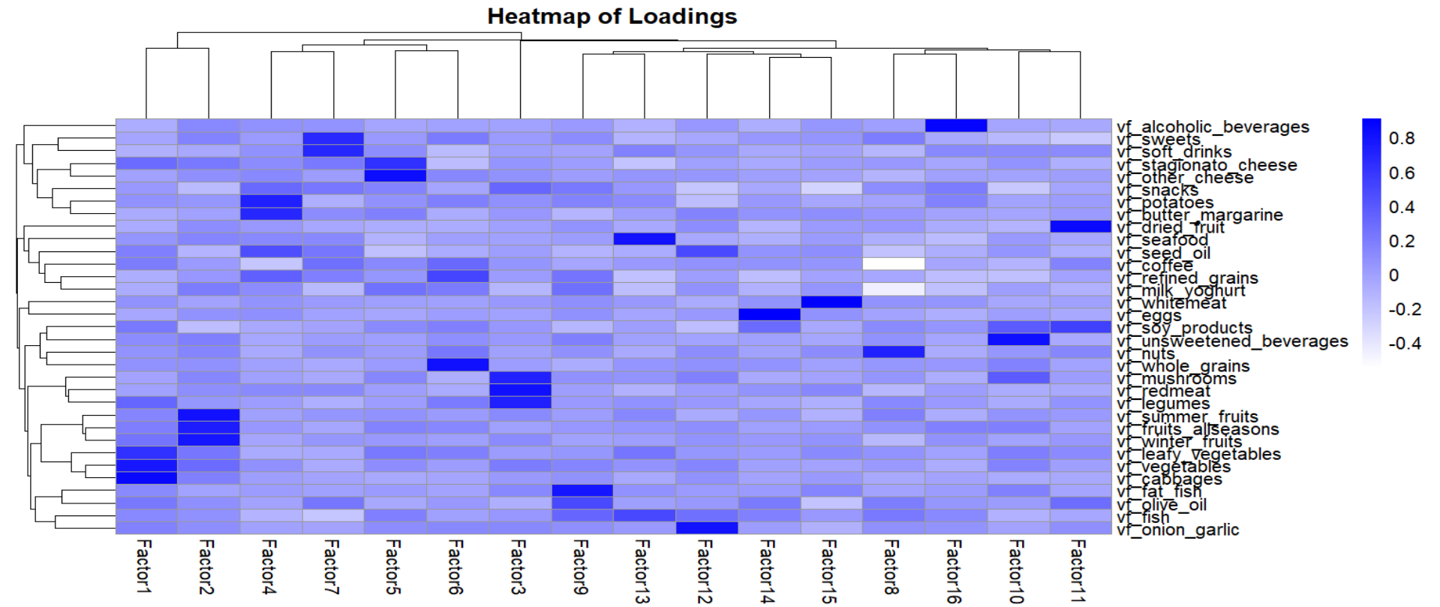
HEATMAP OF LOADINGS FOR 15 FACTORS

Slide 10
LABELING THE FACTORS
based on top 3 variables with highest loading values
Factor1 | "vf_vegetables", "vf_leafy_vegetables", "vf_cabbages” | Green Vegetables
Factor2 | "vf_fruits_allseasons", "vf_winter_fruits" , "vf_summer_fruits" | Fruits
Factor 3 | "vf_redmeat", "vf_legumes", "vf_mushrooms" | Proteins
Factor4 | "vf_potatoes", "vf_butter_margarine", “vf_seed_oil” | Starchy and Fatty Foods
Factor5 | "vf_stagionato_cheese", "vf_other_cheese", “vf_milk_yoghurt” | Dairy Products
Factor6 | "vf_refined_grains" , "vf_whole_grains", “vf_coffee” | Grains and Coffee
Factor7 | “vf_soft_drinks”, “vf_sweets”, “vf_coffee” | Sugary Foods and Drinks
Factor8 | “vf_nuts”, “vf_coffee”, “vf_milk_yoghurt” | Nuts and Dairy
Factor9 | “vf_fat_fish”, “vf_olive_oil”, “vf_fish” | Fish and Olive Oil
Factor10 | “vf_unsweetened_beverages”, “vf_mushrooms”, “vf_soy_products” | Beverages and Soy
Factor11 | "vf_dried_fruit", "vf_soy_products", “vf_olive_oil” | Dried Fruits and Soy
Factor12 | "vf_seed_oil", "vf_onion_garlic", “vf_fish” | Onions, Garlic, and Fish
Factor13 | "vf_seafood", “vf_fish”, “vf_leafy_vegetables” | Seafood and Leafy Vegetables
Factor14 | “vf_eggs”, “vf_soy_products”, “vf_olive_oil” | Eggs and Soy
Factor15 | “vf_whitemeat”, “vf_snacks”, “vf_olive_oil” | White Meat and Snacks
Factor16 | “vf_alcoholic_beverages”, “vf_snacks”, “vf_milk_yoghurt” | Alcohol and Snacks

Slide 11
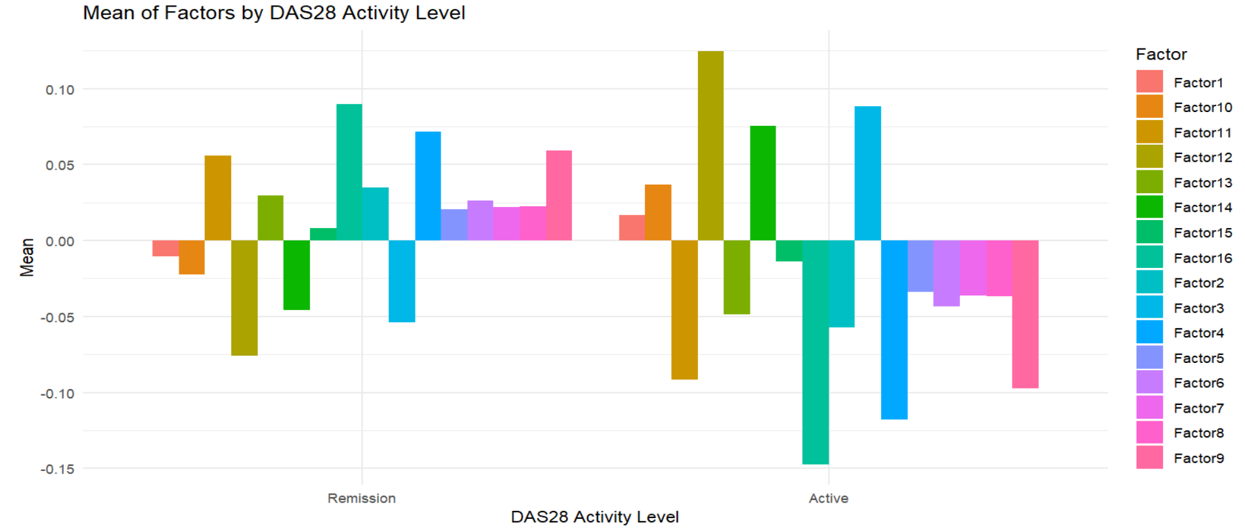
The bar chart illustrates the mean values of the factors for two groups based on the DAS28 activity level: "Remission" and "Active"
Activity status | DAS28_Frequency
Remission | 227
Active | 138

Slide 12

In comparing dietary habits between people with different RA activity levels, those with active RA tend to eat more spices from nature like onions and garlics, fish, and proteins from vegetable such as mushroom or legume. However, they consume less alcohol and snacks as well as less starchy and fatty food like butter compared to those in remission.
In fact, fatty fish like salmon, tuna, mackerel, and trout are rich in omega-3 fatty acids, which are essential for reducing inflammation in the body. Besides, garlic, part of the allium family along with onions and leeks, may help alleviate early signs of osteoarthritis when consumed regularly.

Slide 13
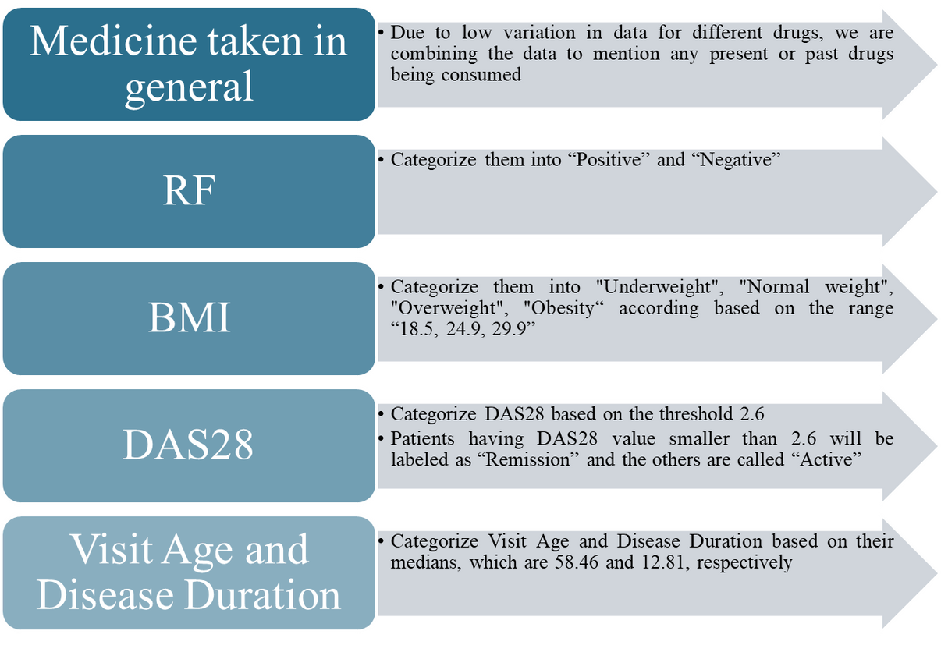
DATA PREPARE FOR REGRESSION
"Water_g"
"Alcohol_g"
"Energy_kcal"
"Visit_Age_Category"
"Disease_Duration_Category"
"Sex",
"Education"
"BMI_Category
"RF"
"GH_PATIENT"
"GERD",
"Gastritis",
"Hypertension"
"DM"
"Cardiopathy"
"TP_CLASSIFICATION"
"Numbiologicals",
"Smoker"
"Animals"
"present_drugs"
"past_drugs",
"any_disinfectant"
"DAS28_Category"

Slide 14
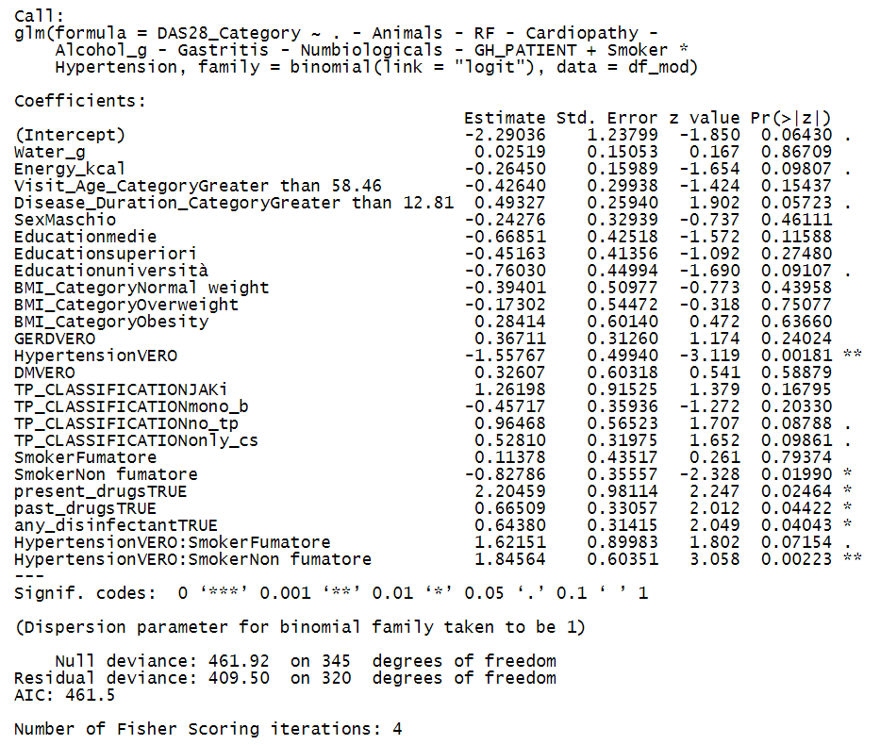
LOGISITC REGRESSION MODEL WITH INTERACTION
"Energy_kcal"
"Disease_Duration_Category"
"Education"
"Hypertension"
"TP_CLASSIFICATION"
"Smoker"
"present_drugs"
"past_drugs",
"any_disinfectant"

Slide 15
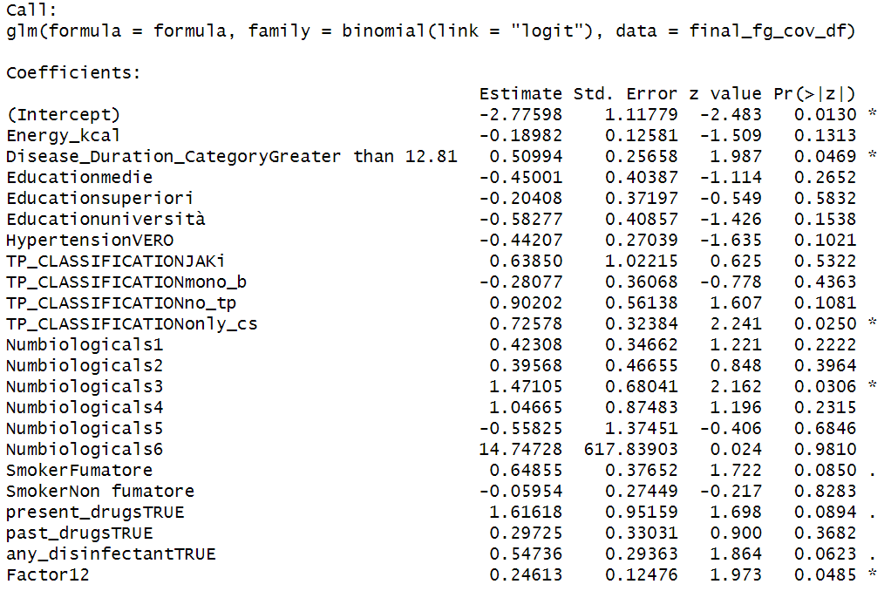
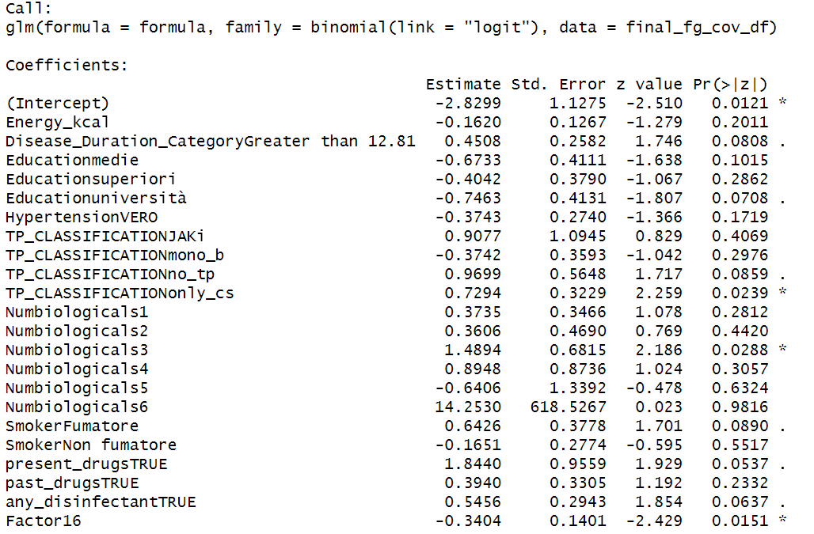
APPLYING LOGISTIC REGRESSION BY CONSIDERING CONFOUNDERS AND 1 FACTOR AT A TIME
Factor 12 and Factor 16 are most significant among 16 factors, with p-value of 0.0485 and 0.0151 (at 10%), respectively
Factor 12 contains food related to group “Onions, Garlic, and Fish”
Factor 16 contains food related to group “Alcohol and Snacks”

Slide 16
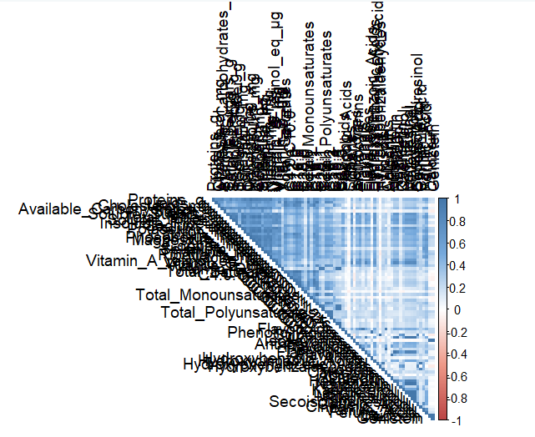
Nutrient Based Analysis
A posteriori approach to identify any pattern in dietary behaviour of Rheumatoid cases based on Nutrients Intake

Slide 17
Methodology
1. Factorial Analysis on Nutrients
2. Selecting Top Factors until a factor is able to explain 5% variance (Leads to 8 Factors)
3. Plotting the Factor Means with Disease Activity (DAS28 / SDAI)
The Disease activity is collapsed into Remission and Active for the two parameters using value 2.6 for DAS28, and 3.3 for SDAI.
4. Clustering using the Factors of Nutrients.
5. Performing Logistic Regression on the confounders and the Factor Groups.
For this, certain variables were transformed to simplify analysis into categorical variables, like present_drugs (combination basede on all drugs), past_drugs, Numbiologicals, BMI, etc.

Slide 18
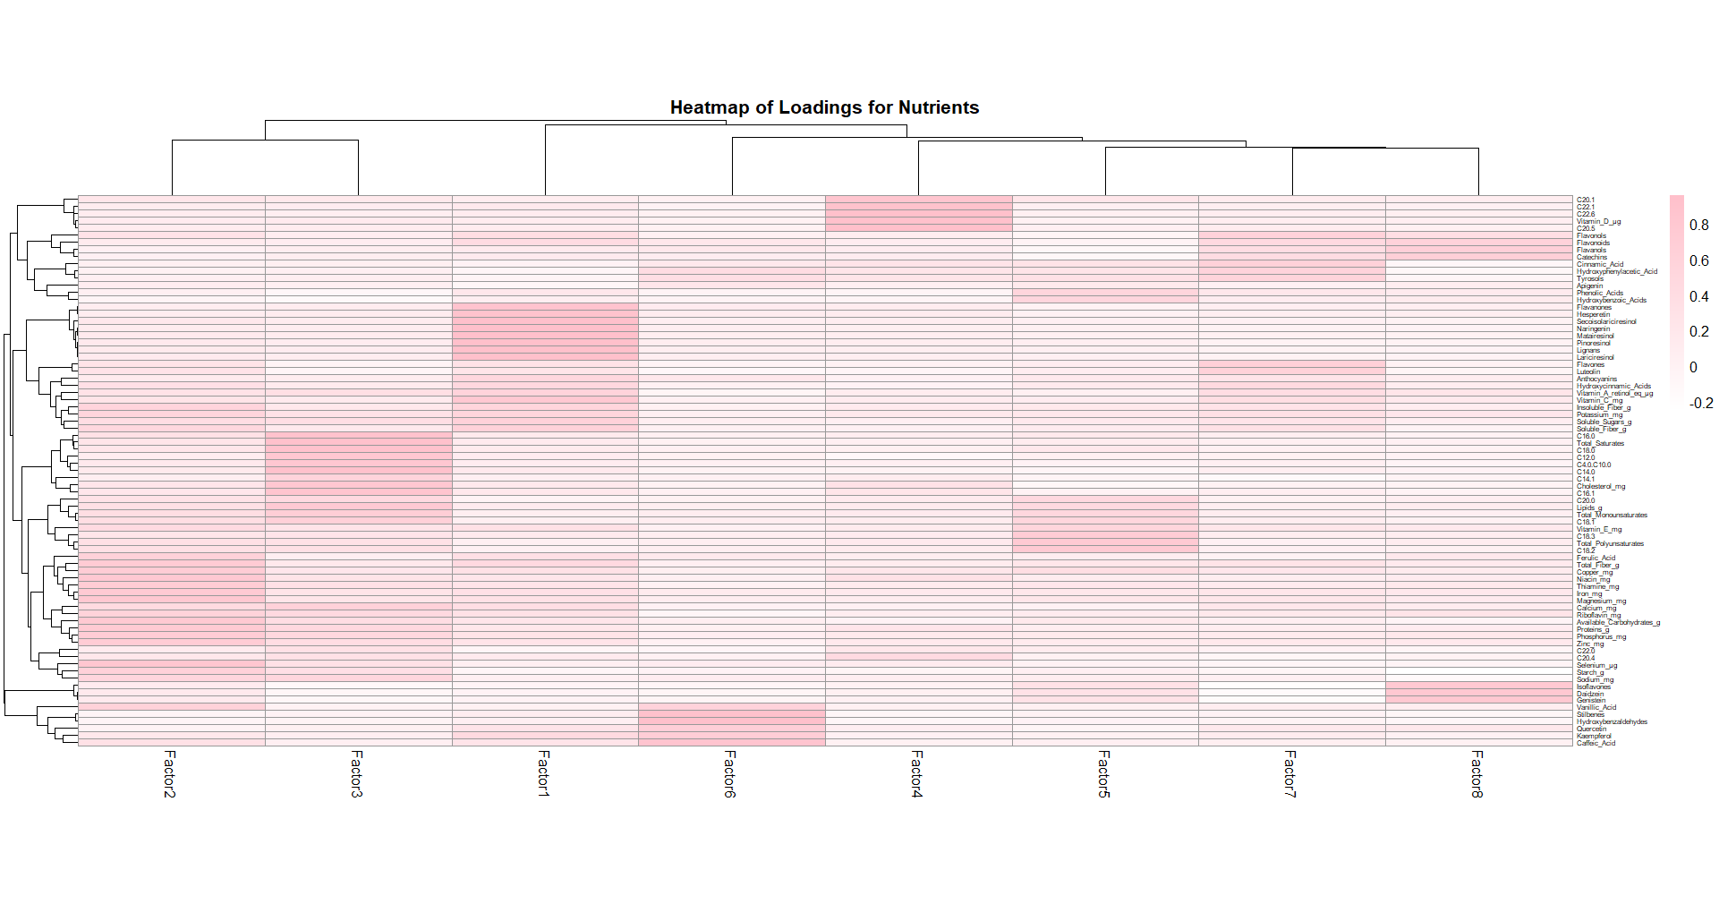

Slide 19
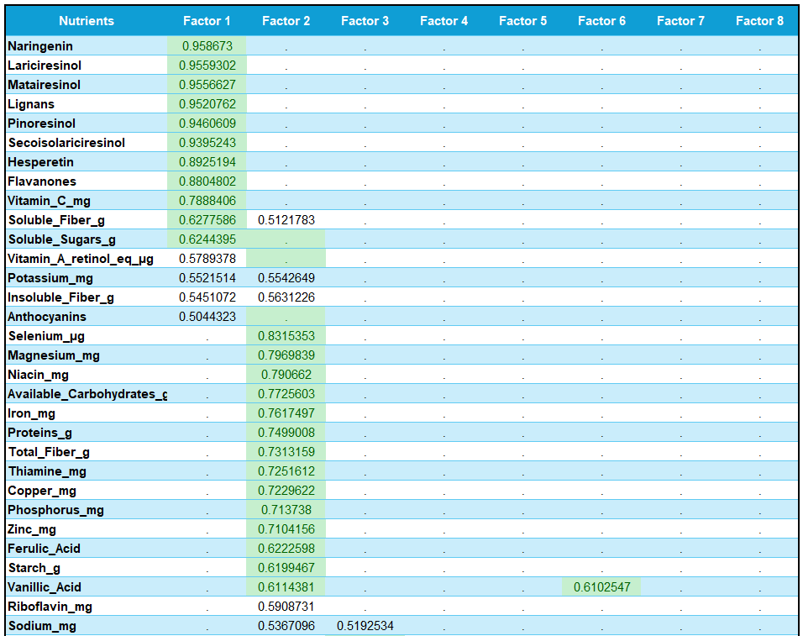
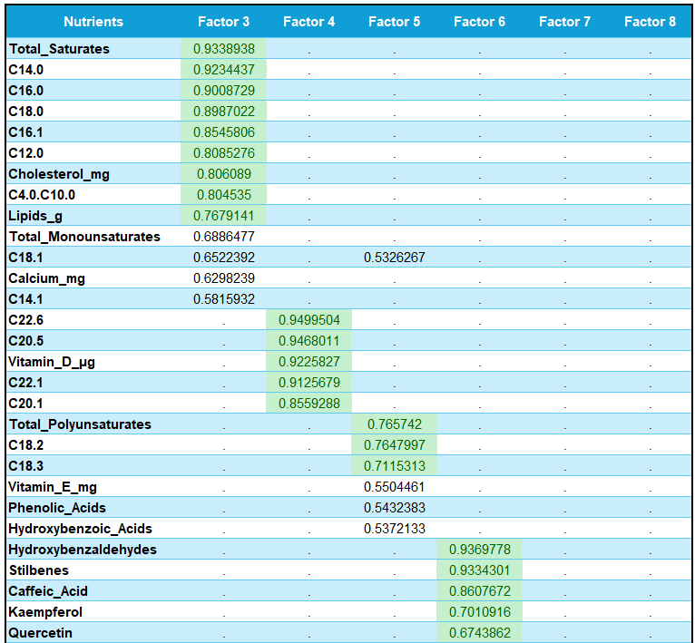
Factor Loadings of Different Nutrients (1/2)

Slide 20
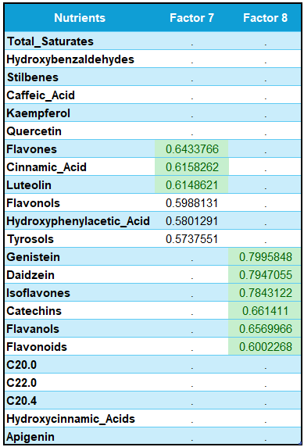
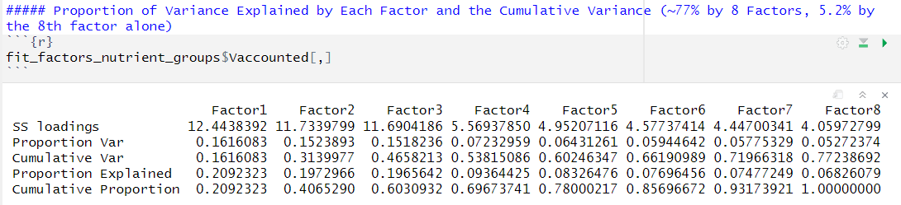
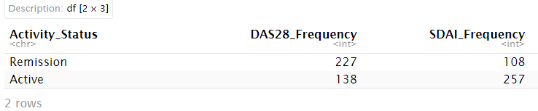
Factor Loadings of Different Nutrients (2/2)
Proportion of Variance Explained and the Cumulative Variance
(~77% by 8 Factors, & 5.2% by the 8th factor alone)
Disease Activity Status

Slide 21
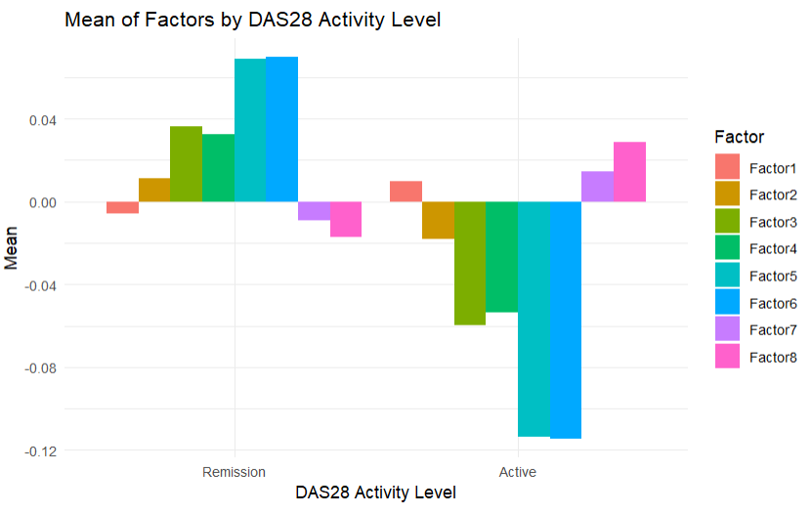
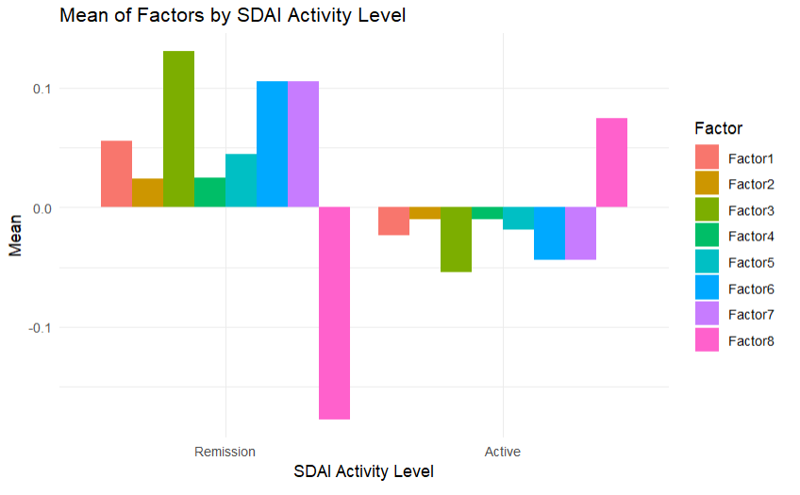
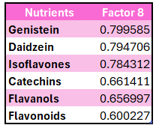

Disease Activity and Nutrient-Factors
These nutrients found are in soy products, tea, cocoa, fruits, berries, etc. Majorly they have anti-inflammation and antioxidant properties.
All of them have antioxidant and anti-inflammatory properties.
As evident from the data also, patients with Active disease are consuming more of these (at least on the face of it).
*Note: There are other anti-inflammatory Nutrients which do show less consumption by Disease Active Patients. One Reason could be that the selected ones just majorly from Soy Products, and tea/caffe. But for more details, we need to study the nutrients in detail.

Slide 22
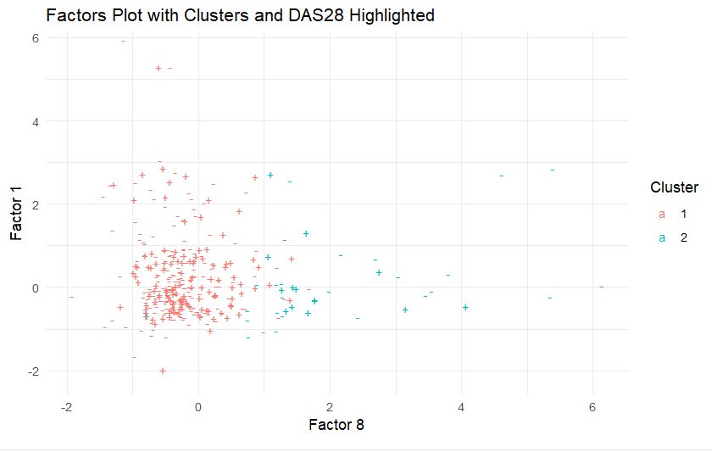
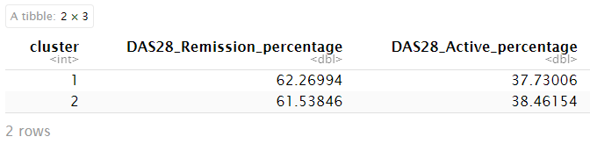
Clustering on Nutrient Factors
Since, there are similar proportion of Remission and Active cases in both clusters, we conclude that the data is not separable using K-Means

Slide 23
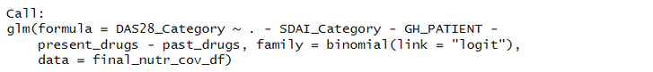
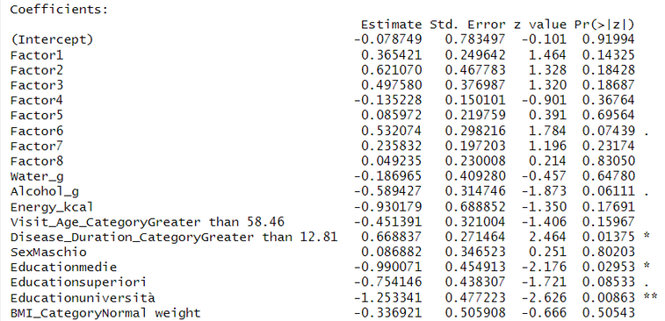
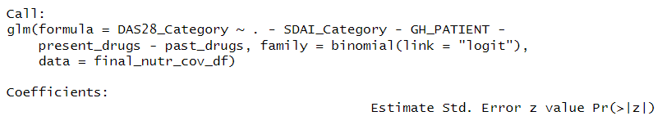
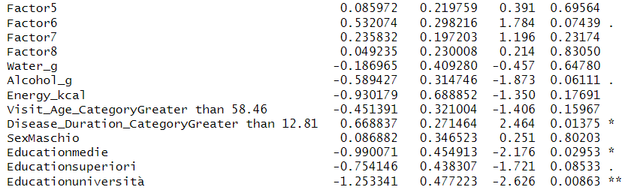
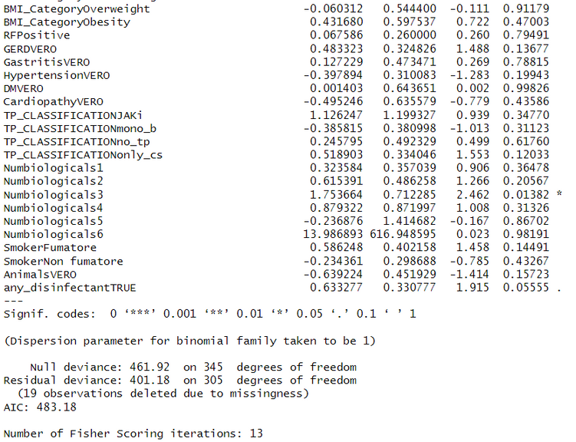
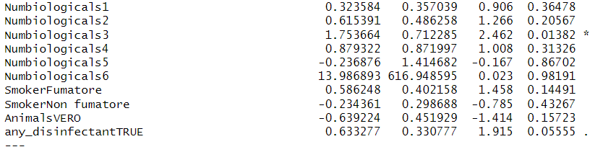
Model without Interaction Effects
The Youngest Serif
Here, we see, Education (University) is highly significant to with p-value <0.01, and beta=-1.25, st-err = 0.4, which means decrease in the log odds of being in a higher category of DAS28 compared to patients with lower levels of education (reference category).
Similarrly, the analysis is for, Numiologicals, and Disease Duration Category , but in these cases, the Beta is +, whichi means they have higher odds of being in DAS28 Active states.

Slide 24

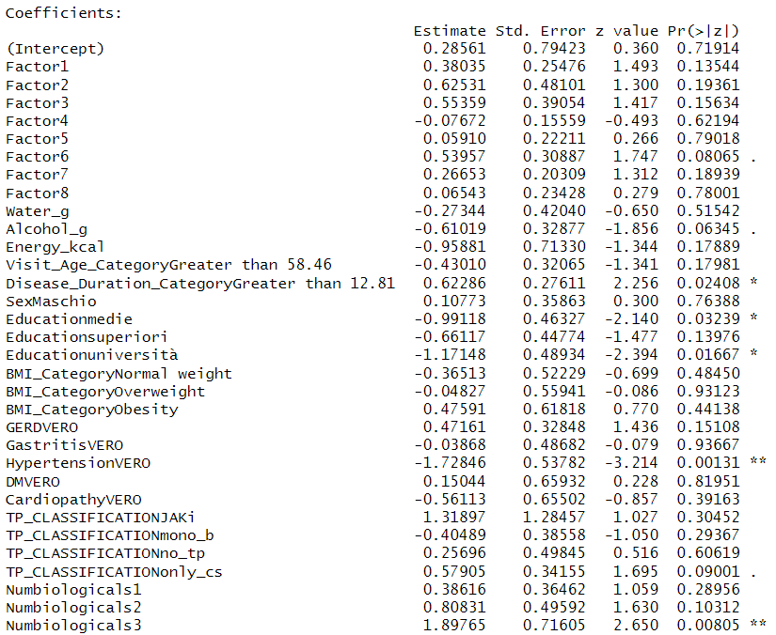
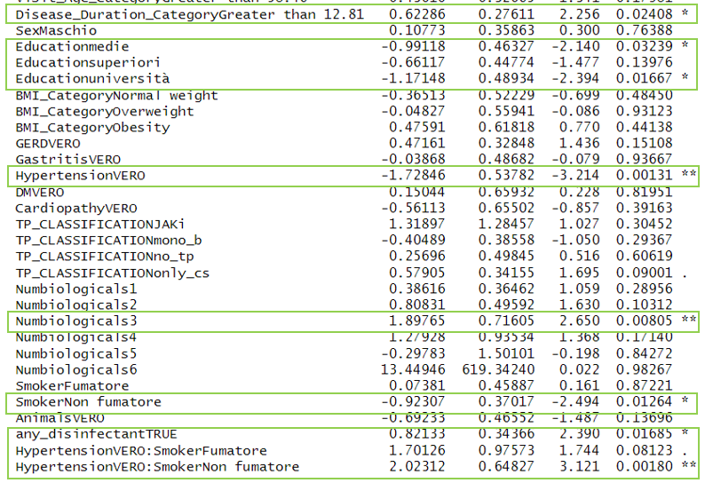
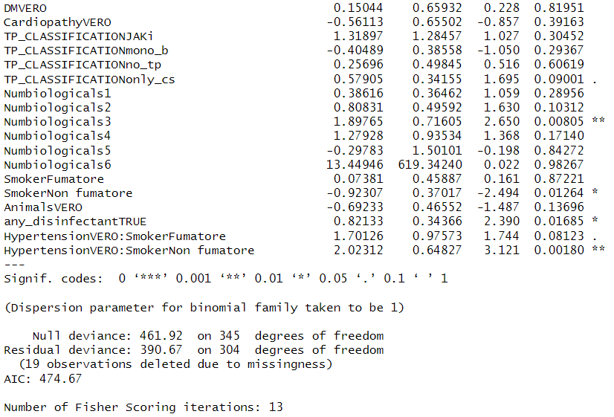
Model with Interaction Effects
Significant Factors ->
Hypertension (Beta = -1.7, p-value = 0.001);
Numbiologicals (Beta = 1.89, p-value=0.008);
Education-Uni (Beta = -1.17, p-value=0.016); Disease Duration (Beta=0.6, p-value=0.02)
anydisinfectant use (Beta=0.82, p-value=0.016)
Alcohol (Beta = -0.61, p-value=0.06)
Nutrient Groups ->
Factor6 (Beta = 0.53, p-value=0.08) *

Slide 25

Findings:
In all, we see that we could only find a slightly significant (at 10%), p-value=0.07 result for Factor6 Nutrients .
Factor 6 Nutrients are (major ones) ->
Vanillic_Acid
Quercetin
Kaempferol
Caffeic_Acid
Stilbenes
Hydroxybenzaldehydes
And most of these comes from Fruits, Onions,Green Vegetables , Berries, Peanuts
So, A Plant-Based Foods.

Slide 26
Shortcomings and how the Analysis can be Improved further -
Cardiopathy and Hypertension -> Both are related to heart disease, we can account for their impact to improve the model.
GERD and Gastritis -> Both are related to Gastric issues, these two can also be combined or need to be addressed to improve model accuracy.
A detailed stratified analysis can be performed for different categories by reducing the confounding effect to verify the results.
Additionally, a dataset with more variation in varaibles could help in further understanding of the disease activity and food habits. Furthermore, there are some data discrepencies in dataset, like total fibres, sugars, saturates etc. not adding up, which when addressed can help in better analysis on the disease activity.

Slide 27
thank
you

Slide 28
APPENDIX

Slide 29
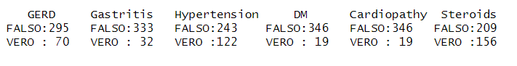
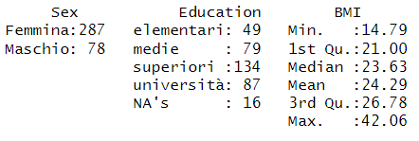

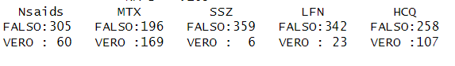
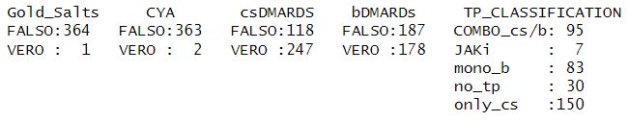
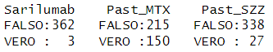
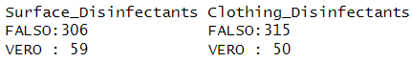
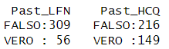
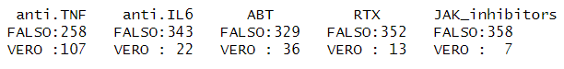
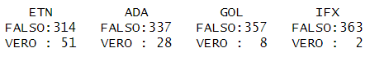
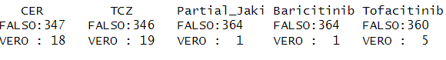
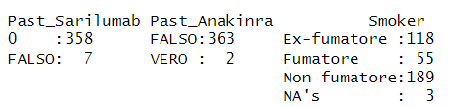
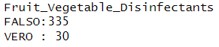
DataSet non-uniformity

Slide 30
